Slide 1

Company Tapestry
NYSE: TPR
Consumer Discretionary – Luxury Retail
Recommendation: BUY
Analyst: Rehya Satish
April 14, 2023

Slide 2
Investment Thesis
Recommendation
Tapestry (NYSE: TPR) controlling approximately 9% of the US market continues to keep up with their competitors, their net profit margin is at 12.69%. Additionally, their average return on invested capital was around 17% in 2018 then dipped to its all-time low of 1.6% in 2020 amid covid, but is bouncing back and is currently at 16.27%. They are out performing their major competitors Capri with a return of 12.67%, Guess at 12.78%, and Fossil at 1.85%. Throughout 2022 TPR has kept their ROE above 25% going as high as 35.66% again out performing their major competitors with fossil ROE in the negatives. With tapestry consistently keeping up their competitors. This is why we recommend a BUY for TPR.
Rationale
In 2023 spending is expected to return to pre pandemic levels which would increase revenue and expand margins, Consumer cash flow was expected to rise by 2 percent in the first quarter, and rise to 6 percent-plus in the second half of 2023. Consumer spending has increased 1.1%, which is also the biggest gain since March 2021. Additionally Tapestry is tapping into a market the majority of other high-end luxury brands do not focus on. They are tapping into the accessible/affordable luxury item. This market contains the majority of the population. They are also tapping into this market by expanding into China. TPR represents a stable investment for the following reasons:
1
Spending returning to pre pandemic levels
2
Targeting the accessible luxury market which is currently untapped
3
Expansion into China
Price Target: $47.68 Current Price: $43.11 Premium: 10.6%

Slide 3
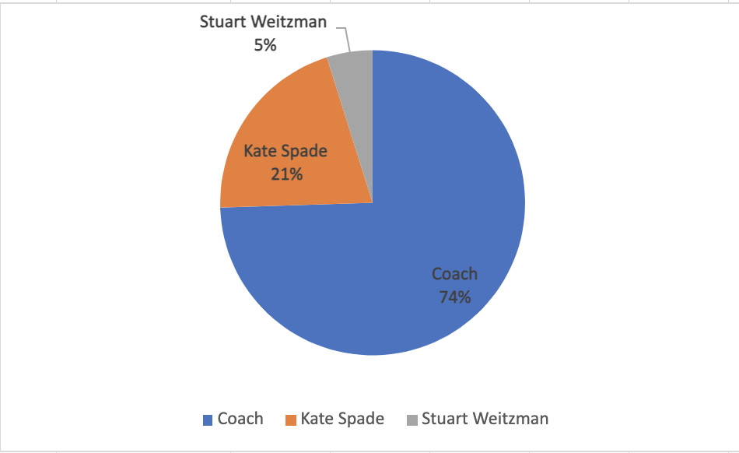
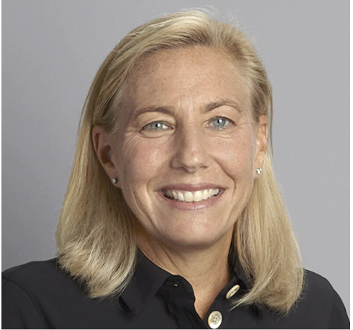
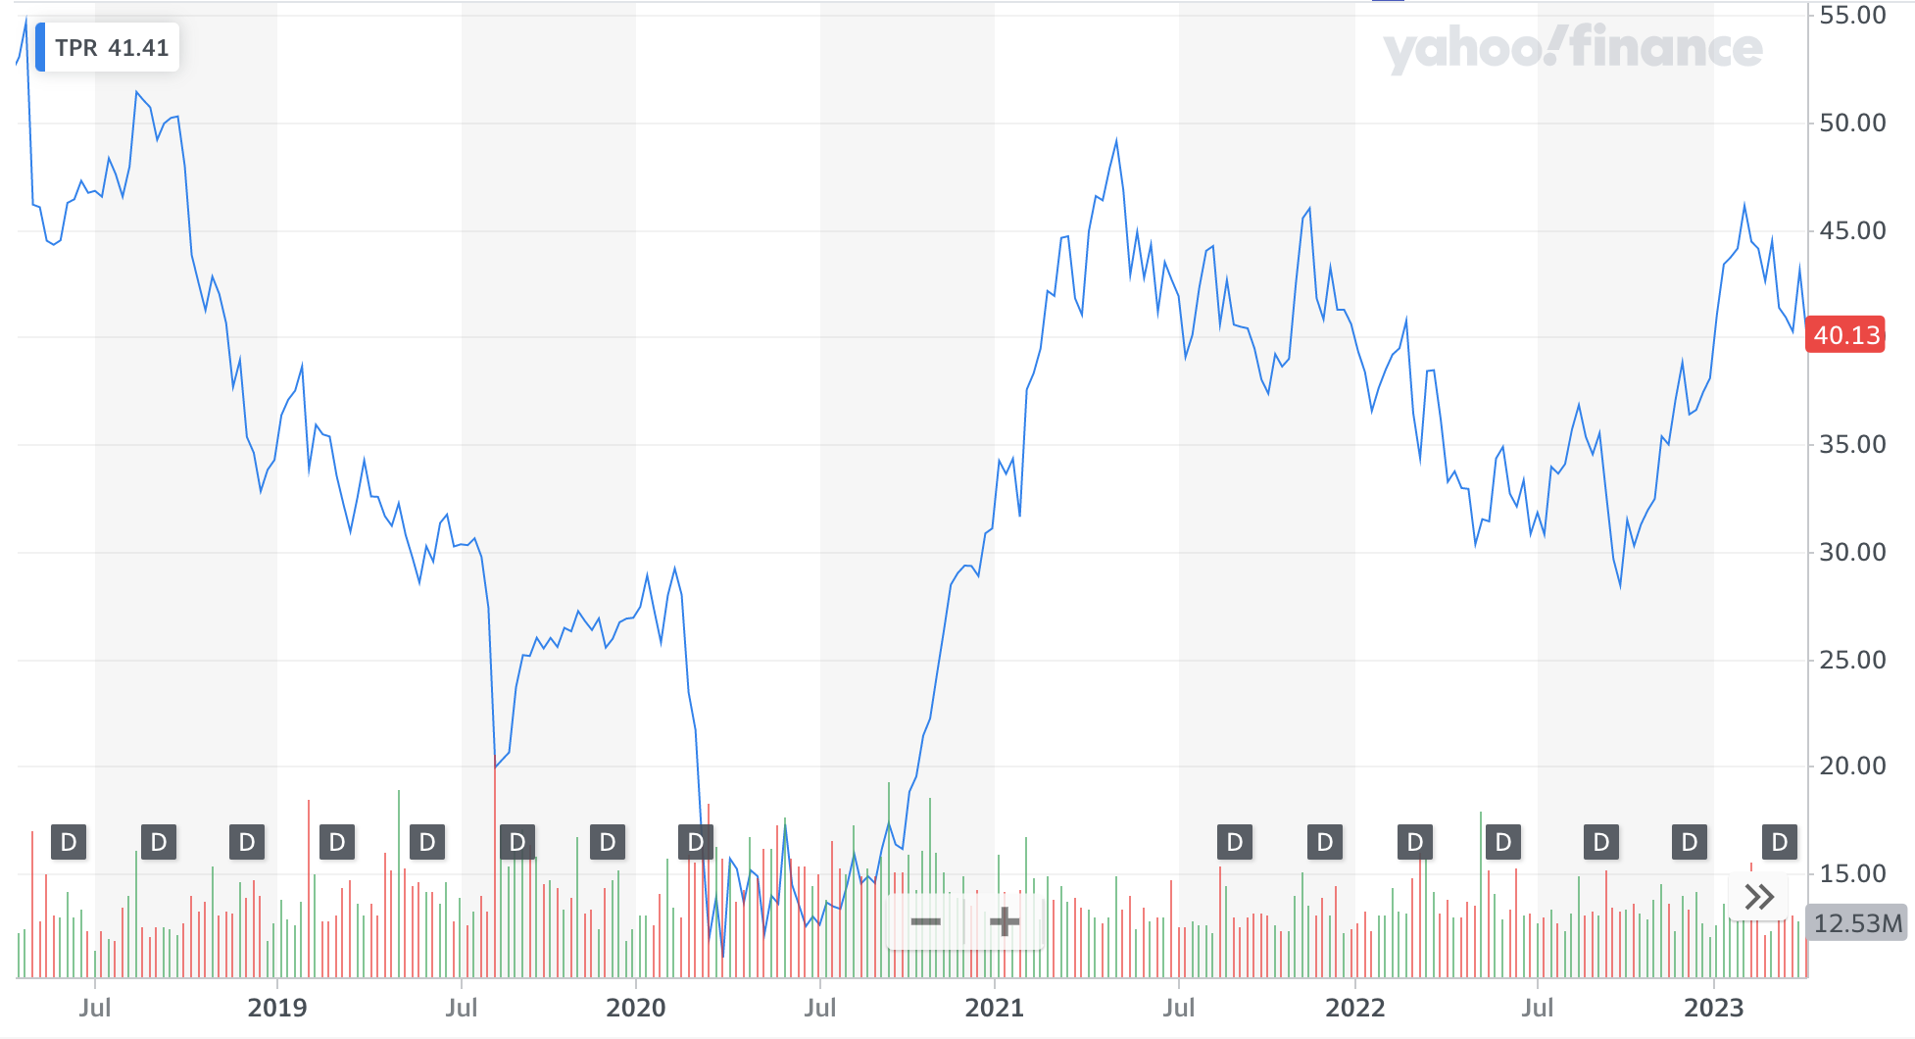
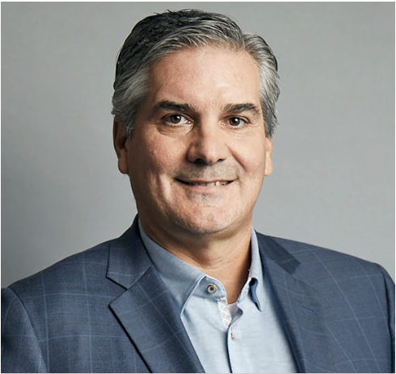
Company Overview
Company Profile
Revenue Breakdown
Tapestry, Inc. was founded in 1941 and is headquartered in New York, New York.
Provides luxury accessories and branded lifestyle products in the United States, Japan, Greater China, and internationally
The company operates in three segments: Coach, Kate Spade, and Stuart Weitzman. It offers women's accessories
1,443 Tapestry Inc. stores in operation worldwide
Key Stats
Revenue
$4.961B
EBITDA
$106.00
Mkt. Cap
$9.546B
D/A Ratio
5.0x
P/E Ratio
12.00x
Management Team
5-Year Performance
Joanne Crevoiserat – CEO
Joined TPR in 2019 as CFO She also serves on the Board of Directors
Prior to TPR(2017-2019) she served as Executive Vice President and COO for Abercrombie & Fitch Co.
received a Bachelor of Science degree in Finance from the University of Connecticut
Scott Roe – CFO
Appointed as CFO is 2021
Joined from VF Corporation where he has served as CFO since April 2015
Graduated with honors with a Bachelor of Science degree in Accounting from the University of Tennessee
Current Price: $40.13

Slide 4
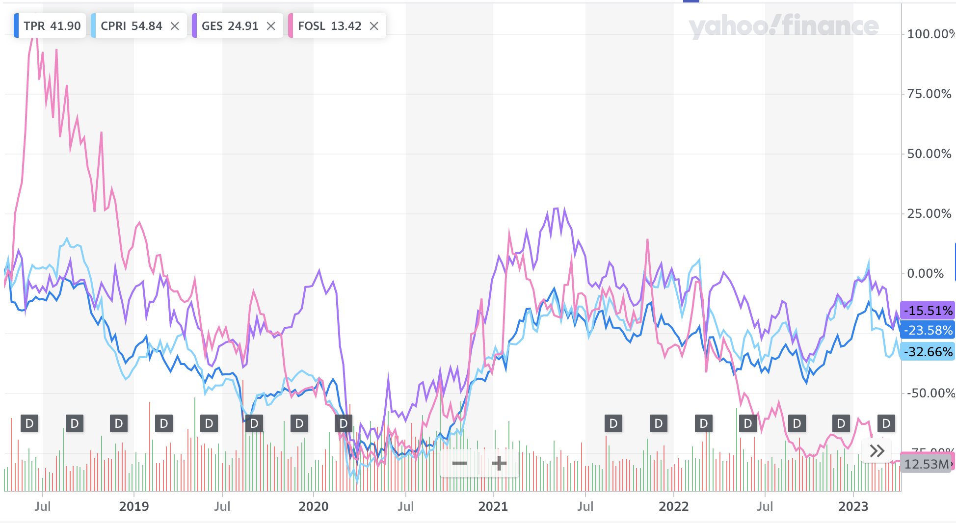



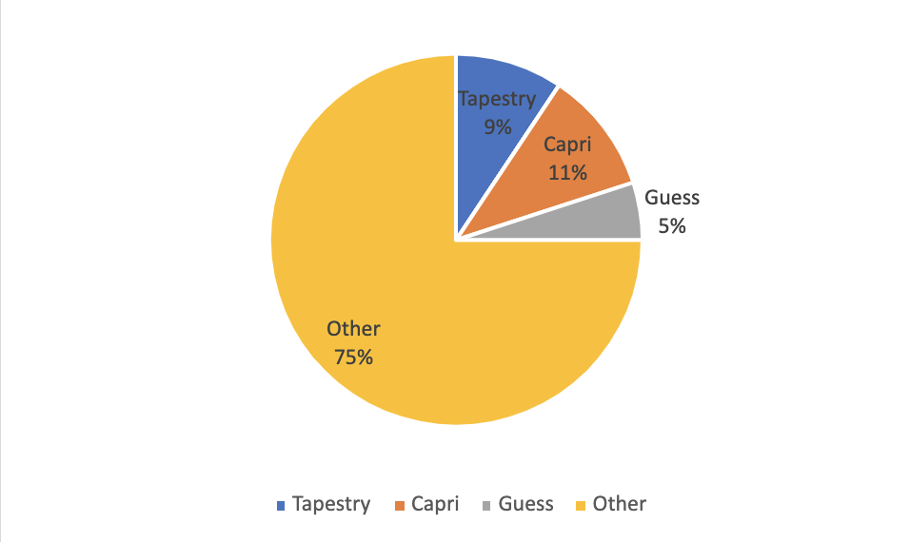
Industry Analysis
Major Competitors
Tapestry-Competitors Yearly Revenue Change
Market Cap | 2022 Revenue | Market Share | P/E Ratio
$164.60M | $1.68B | 3.01% | 17.85x
$5.5B | $5.654B | 10.65% | 7.42x
$1.08B | $2.66B | 5.0% | 8.341x
Market Share
Industry Trends & Drivers
Gen Z and millennials are the largest drivers of the luxury-goods market
Gen Zers purchase luxury items three to five years earlier than millennials
The luxury-goods market is valued at more than a trillion dollars and is expected to withstand a recession
Want for sustainable, diverse, and tech-savvy luxury brands
By 2030, Gen Z and Gen Alpha will make up a third of the luxury-goods market
Spending by Gen Z and Alpha is predicted to increase three times faster than older generations
Notes:
BICO gives research

Slide 5
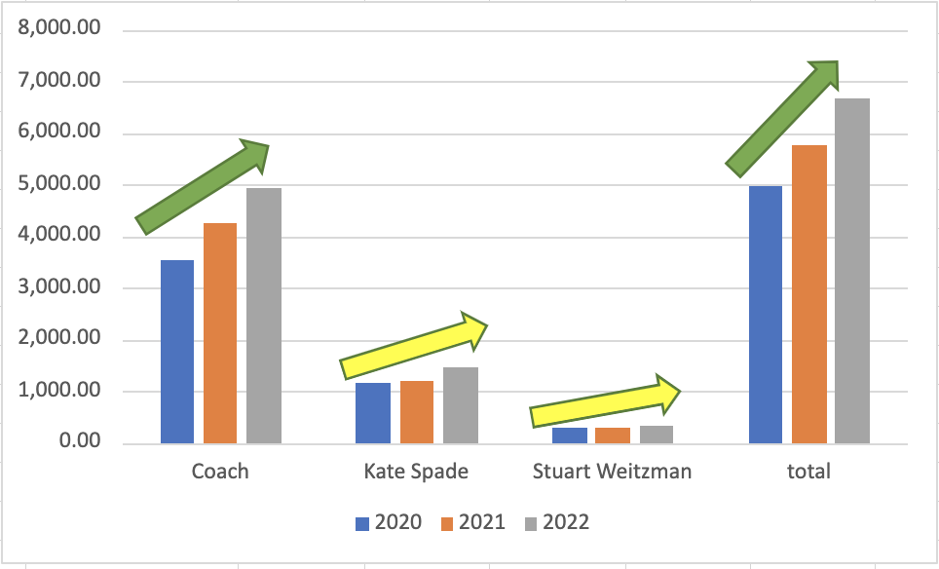
Operating Segments
Coach
Kate Spade
Stuart Weitzman
Specializes in leather handbags, luggage, and accessories, as well as ready-to-wear
Coach peak revenue was $6.7B in 2022
Coach annual revenue for 2021 was $5.7B, a 15.82% growth from 2020
Coach annual revenue for 2022 was
$6.7B, a 16.33% growth from 2021
Steadily increasing web traffic with an estimated 100% YoY growth
Sells handbags, clothes, shoes, jewelry, and home décor
Successful track record of developing new products as well as product innovation.
Successful record of integrating complementary firms through mergers or acquisitions
19.5% increase in sales from 2021
Premium footwear brand
Expected to overperform the market in the coming years
Forecasts to increase revenues from $317.7 million to $450 million in fiscal 2025
Sales by Segment (in millions)
Notes:
Travel & Consumer: Primark, Hotels.com, Southwest, Bacardi
Financial: UBS
Business Info & Media: Adobe, Epic Games
Partnered with AWS, Google, & Salesforce
Other verticals: Boston College, Cengage, Marathon

Slide 6
Tapestry Upcoming Projects
Coach
Expansion into China
Tapestry announced a three-year roadmap to drive sustainable, profitable growth
Includes plans to hit $8 billion in revenue
Compound annual growth rate of 6-7% compared to current earnings
Return a total of $3 billion in capital to shareholders
Banking on the repositioning of Coach to help it achieve this growth
Planning to expand into China in 2023
Allows Tapestry, one of the largest luxury retailers in China to capitalize on its position in accessible luxury
Louis Vuitton, Gucci, and Burberry have an established presence in China's biggest cities
Tapestry is focusing on cities on the lower end of economic output, consumer behavior, and population size

Slide 7
Final Recommendation
Base Case
Price Target: $47.68
Current Price: $43.11
Upside Premium: 10.6%
Recommendation:
TPR will continue to outperform its peers as the leader in luxury goods by continuing capitalizing an untapped consumer base and continuing their global expansion. We believe a BUY is the best decision.

Slide 8
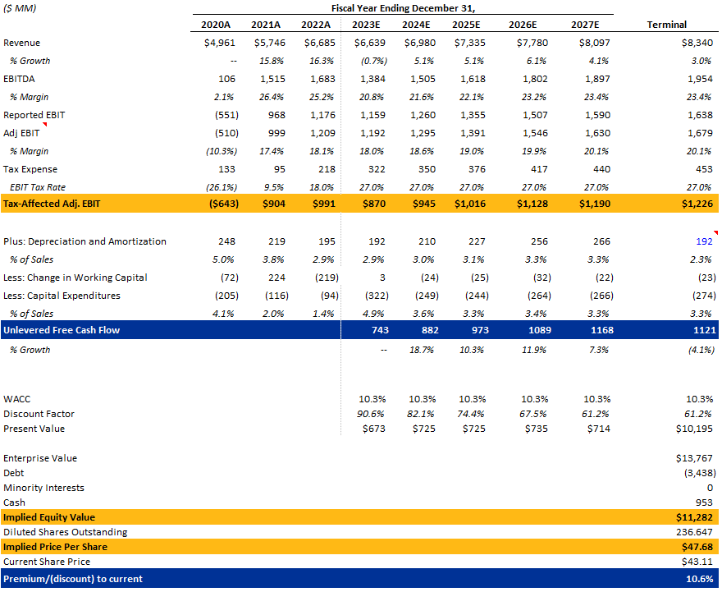
Valuation (DCF)

Slide 9
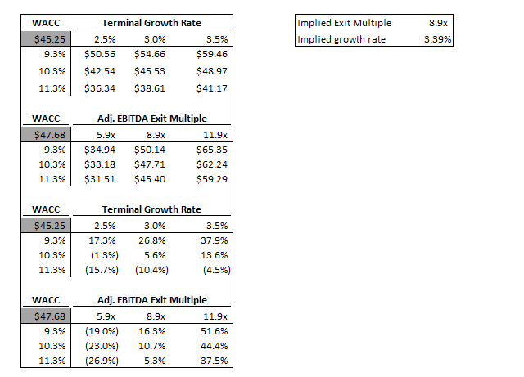
Sensitivity Analysis

